Slide 1
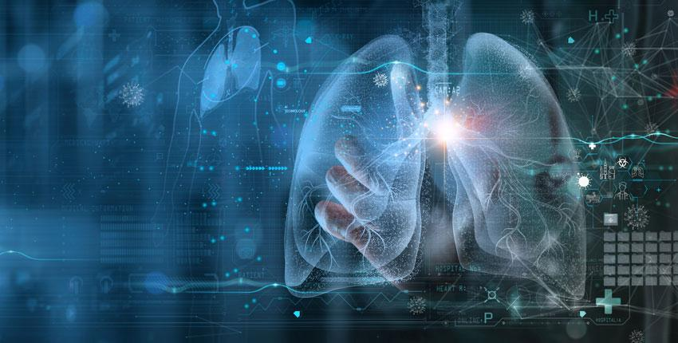
MACHINE LEARNING ALGORITHMS TO PREDICT LUNG CANCER
MICHELLE HARRIS, DRISHTI PATEL, PRIYANSHU RANA
Notes:
Today, we stand before you to shed light on a topic that touches the lives of millions worldwide: lung cancer. It's a disease that not only affects individuals but entire families and communities. But amidst the challenges posed by this formidable adversary, there's hope. And today, I bring you a glimpse of that hope in the form of cutting-edge technology.
Lung cancer, as many of you may know, is one of the most prevalent and deadliest forms of cancer globally. Its impact extends far beyond the physical toll it takes on those diagnosed. It ripples through emotional and socioeconomic spheres, leaving an indelible mark on countless lives.
But what if we could intervene before the disease strikes? What if we could identify those at risk and empower them with knowledge and resources to mitigate that risk? Enter the ground-breaking innovation of predictive analytics.
Imagine a tool—a neural network model—that harnesses the power of data to assess an individual's likelihood of developing lung cancer based on their lifestyle factors. This isn't science fiction; it's the intersection of healthcare and artificial intelligence, offering a glimpse into a future where prevention takes precedence over cure.
This model, crafted by Drishti, Priyanshu and myself, analyses an array of variables—from smoking habits to environmental exposures—and generates personalized risk assessments. Armed with this information, individuals can make informed decisions about their lifestyle choices, potentially altering the course of their health trajectory.
But this isn't just about individuals; it's about collective action. By leveraging technology to predict and prevent lung cancer, we can shift the paradigm from reactive healthcare to proactive wellness. We can empower communities to embrace healthier lifestyles and advocate for policies that promote lung health.
As we stand on the cusp of a new era in healthcare, let us seize the opportunity to harness the full potential of technology in the fight against lung cancer. Let us embark on a journey where every data point, every algorithm, and every innovation brings us closer to a future where this disease no longer holds sway over our lives.
Together, let us dare to dream of a world where lung cancer is not just treatable but preventable. Thank you.

Slide 2
Overview
What is lung cancer?
Objective
Our process (ETL, dependencies etc)
Data analysis using python and tableau exploration
Machine learning models
Optimisation
Web application

Slide 3
What is lung cancer?
Cancer starts when abnormal cells grow and multiply in an uncontrolled way. Primary lung cancer is when this process begins in the lungs. If it commences in another body area and spreads to the lungs it is known as secondary or metastatic cancer in the lung.
Lung cancer is a leading global cause for deaths and the fifth most common cancer diagnosed in Australia.
Almost one in five cancer deaths in Australia occur from lung cancer.
An estimated 14,700 people were diagnosed with lung cancer in 2023.
Reference - Cancer Council Australia

Slide 4
Objective
The purpose of this project is to create an algorithm that can be used to predict lung cancer risk as low, medium or high with a greater than 75% accuracy. This is achieved by analysing a lung cancer dataset containing 1000 records sourced from Kaggle.
Can we predict a person's cancer risk with greater than 75% accuracy using a neural network model?
What additional risk factors make a person more susceptible to lung cancer?

Slide 5
Dependencies
Python Pandas
Python Matplotlib
Scikit-learn
Tensorflow
PySpark
Tableau
Flask
The project was completed using jupyter notebook on Google collaboratory for analysis and model development.
Web page application using python and flask on visual studio code.

Slide 6
ETL
EXTRACT
Extract data from Kaggle as a CSV, limited null values.
TRANSFORM
Check for nulls, removes unnecessary columns, change dtypes for consistency, converted levels to numerics
LOAD
Load the data into a jupyter notebook on colab, use Spark to retrieve data and analyse.

Slide 7
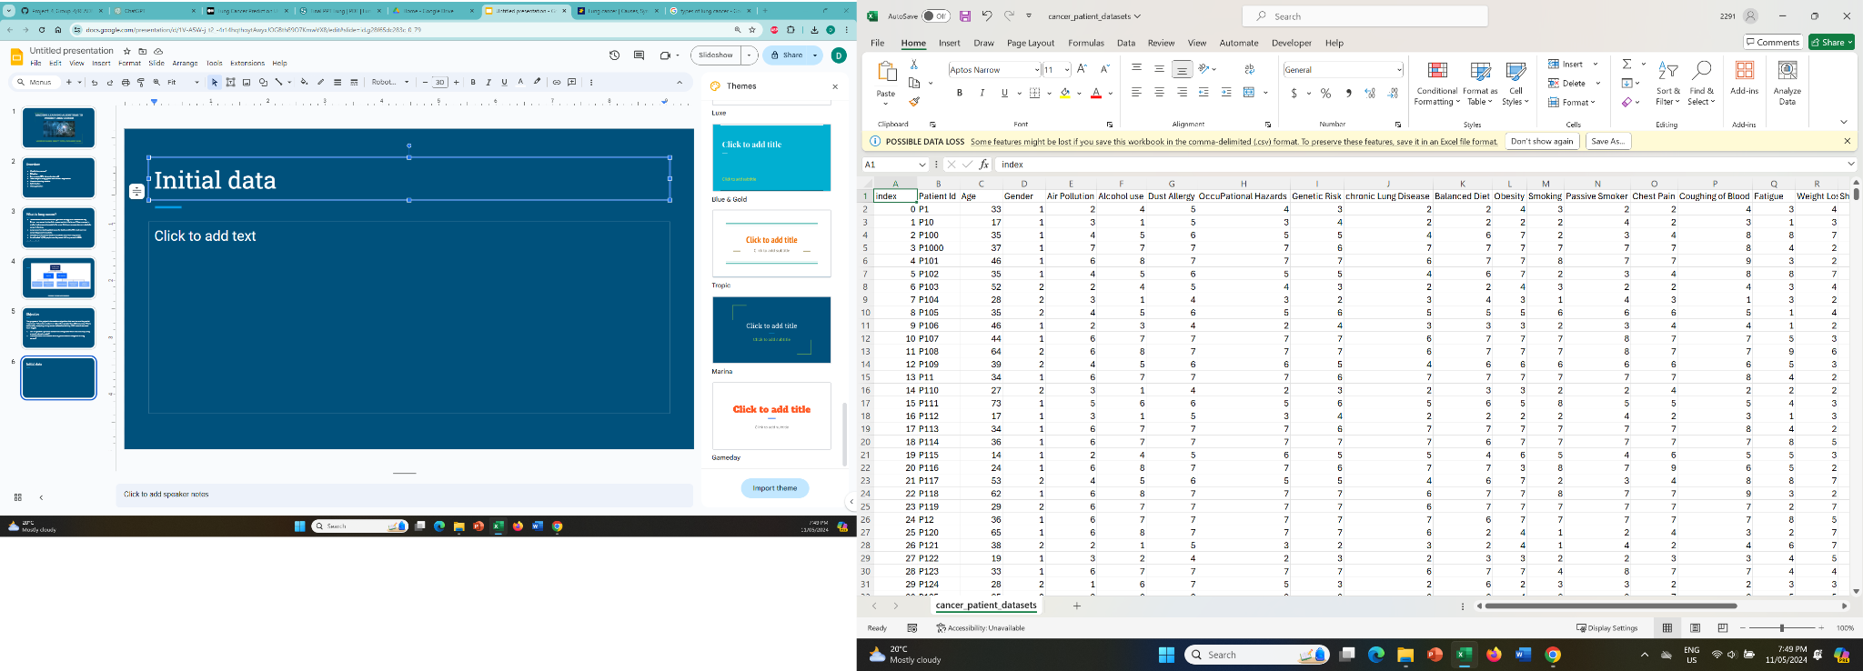
Initial data
Age
Gender
Air pollution exposure
Alcohol use
Dust allergy
Occupational hazards
Genetic risk
Chronic lung disease
Balanced diet
Obesity
Smoking
Passive smoker
Chest pain
Coughing of blood
Fatigue
Weight loss
Shortness of breath
Wheezing
Swallowing difficulty
Clubbing of finger nails
Snoring

Slide 8
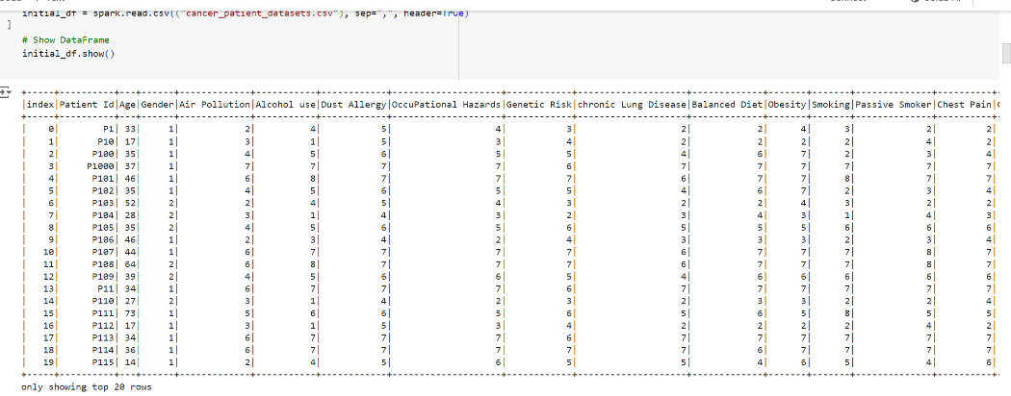
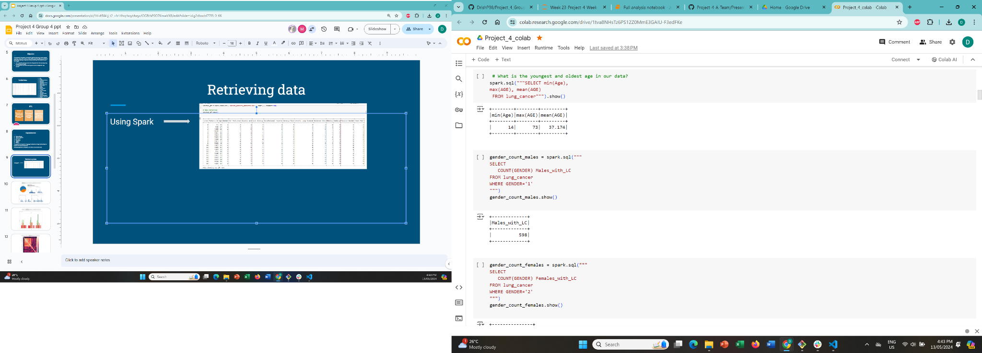
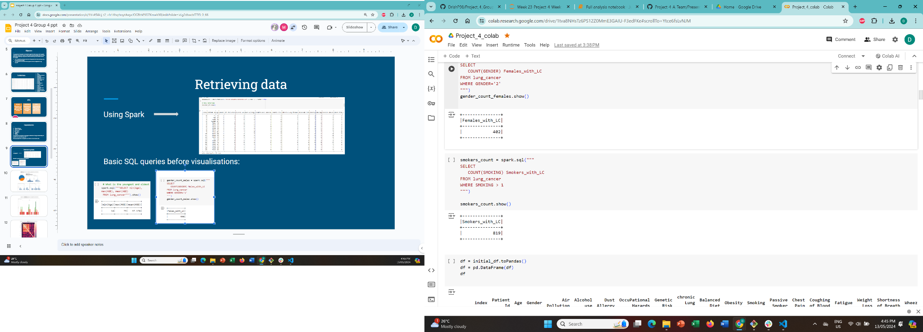
Retrieving data
Using Spark
Basic SQL queries before visualisations:

Slide 9
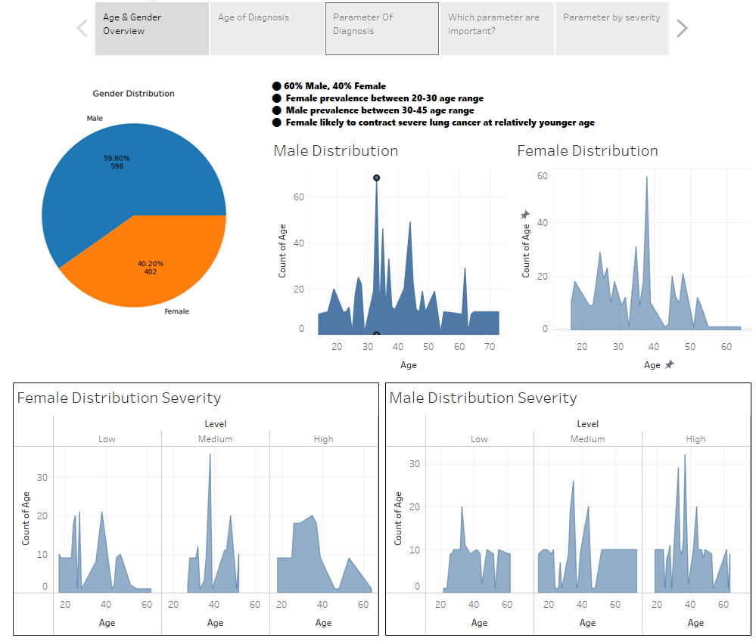
Overview of Dataset
Age & Gender

Slide 10
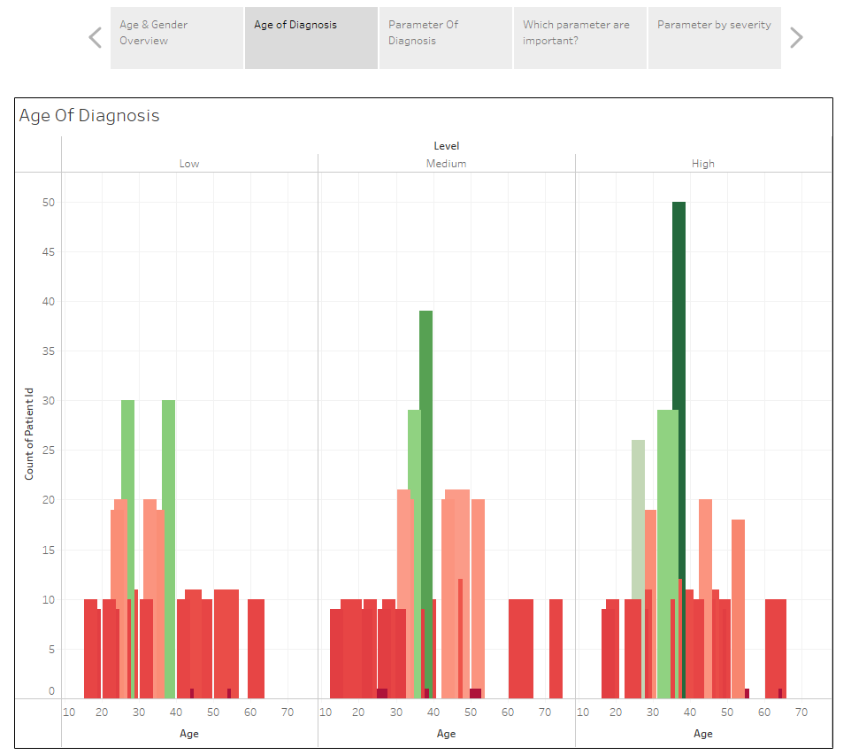

Slide 11
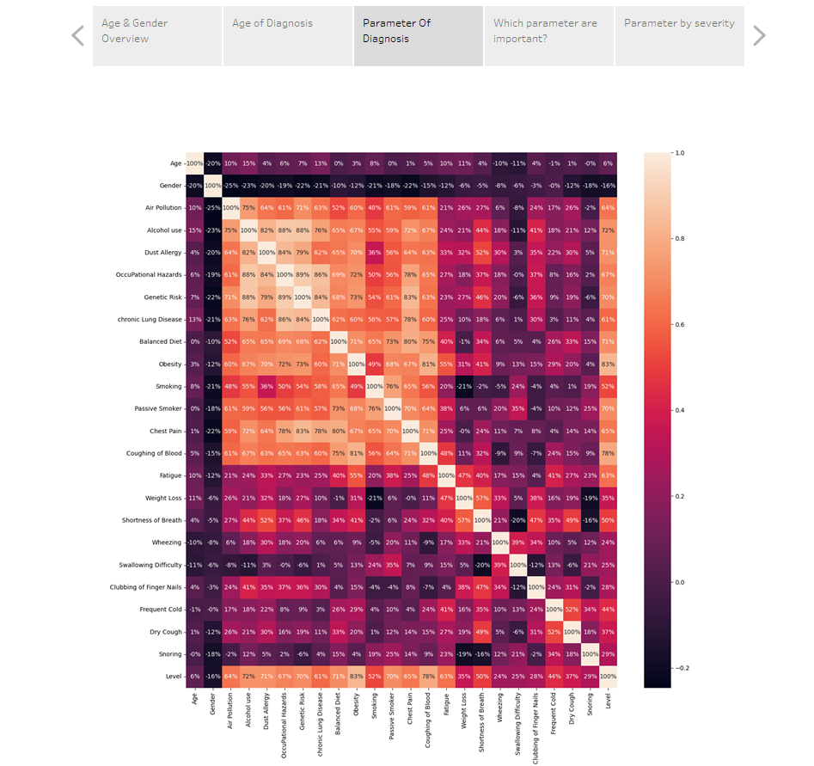
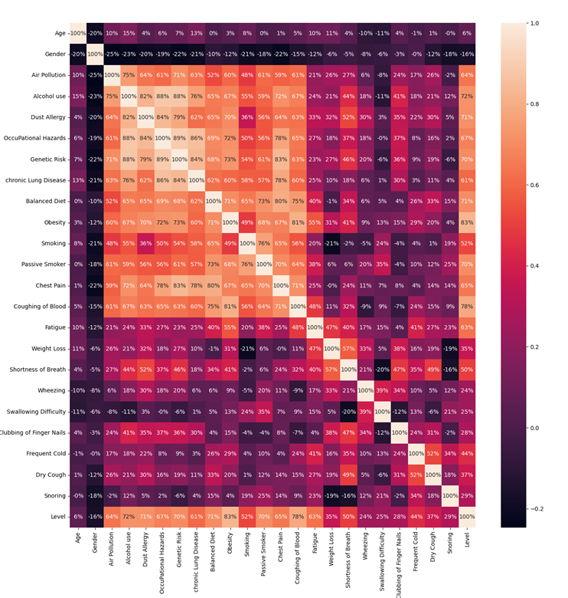
Regression Model to Find Significance

Slide 12
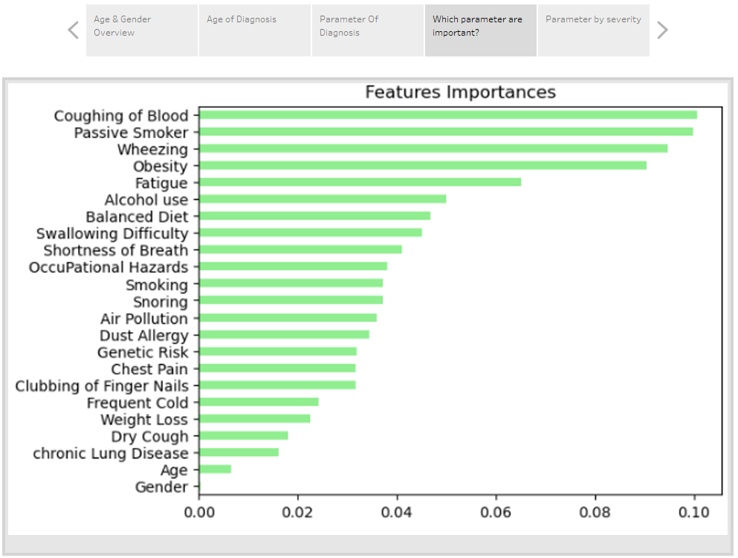

Slide 13
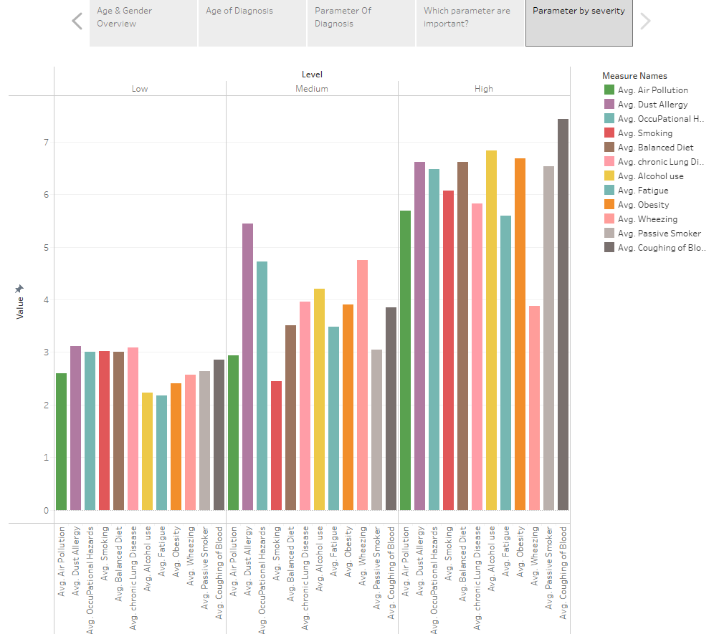

Slide 14
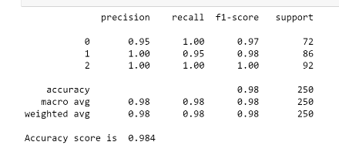
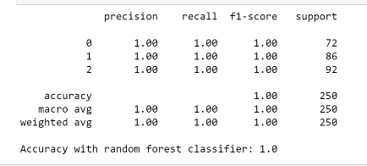
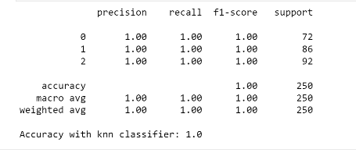
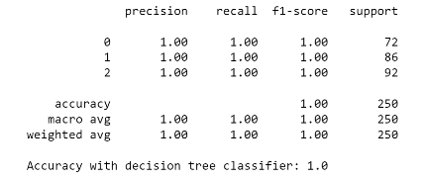
Models
Logistic regression

Slide 15
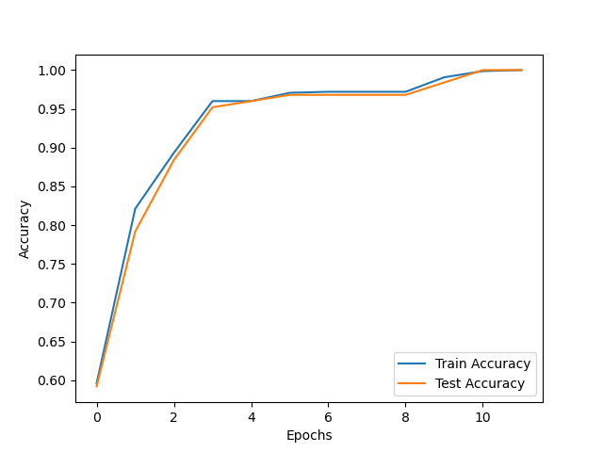
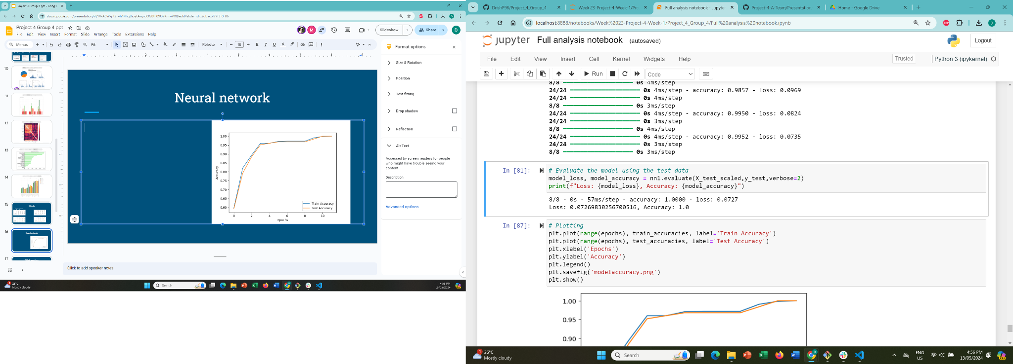
Neural network
Final chosen model for prediction -deep neural model
Autotuner for optimisation
Evaluation

Slide 16
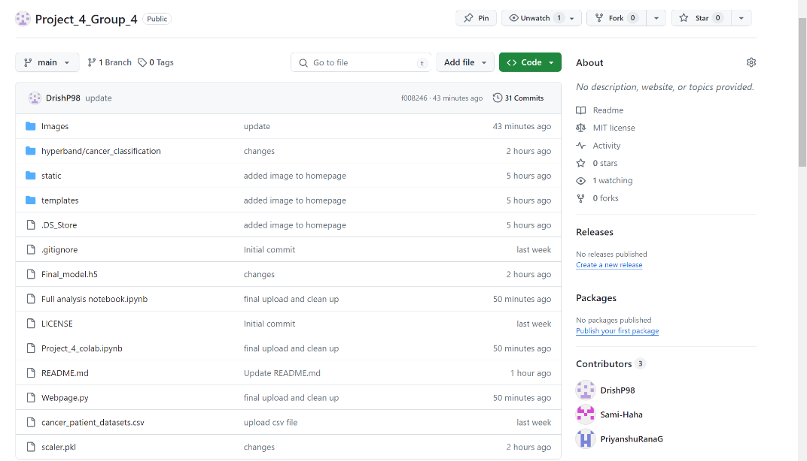
Github repository
The web application can be run as a Flask app through the Webpage.py file

Slide 17
Challenges to this project
Model choice
Autotuner
Deployment

Slide 18
Limitations to data
Data in numeric values only with no explanation, we assumed this was severity of symptoms in ascending hierarchy.
Assumed males were n=1 in the data set based on kaggle comment section.
Small data set - only 1000 records.

Slide 19

Conclusion
Machine learning is a powerful tool to predict healthcare outcomes and more can be achieved with comprehensive data and emerging tools!

Slide 20
References
https://www.kaggle.com/datasets/thedevastator/cancer-patients-and-air-pollution-a-new-link/data
https://scikit-learn.org/stable/
https://www.lung.org/lung-health-diseases/lung-disease-lookup/lung-cancer/basics/lung-cancer-types
https://spark.apache.org/docs/latest/api/python/index.html
https://keras.io/api/models/
https://keras.io/api/metrics/
https://www.tensorflow.org/tutorials/keras/keras_tuner

Slide 21

Thank you Sean and Rong!

